Slide 1
W4111 – Introduction to Databases Section 003, V03, Fall 2024 Lecture 5: ER(4), Relational(4), SQL(4)
© Donald F. Ferguson, 2024

Slide 2
W4111 – Introduction to Databases Section 003, V03, Fall 2024 Lecture 5: ER(4), Relational(4), SQL(4)
We will start in a few minutes.
© Donald F. Ferguson, 2024

Slide 3

Today’s Contents
3 | COMS W4111_003_2024_3: Lecture 5: ER(4), Relational(4), SQL(4) © Donald F. Ferguson, 2024

Slide 4
Contents
Introduction and course updates.
ER Modeling (4).
Relational model and algebra (4).
SQL (4).
Homework and projects.

Slide 5
Introduction and course updates
5 | COMS W4111_003_2024_3: Lecture 5: ER(4), Relational(4), SQL(4) © Donald F. Ferguson, 2024

Slide 6
Course Updates
Questions?
Homework 2
Will come out in two parts.
HW2a this weekend and due in one week.
HW2b midweek and due after the midterm.
Working on HW2b is excellent study prep for the practical questions on the midterm.
Part of HW2b will also be the nucleus of your “project.”
Midterm Exam
18-OCT in the classroom from 10:10 to 11:30.
Written exam “on paper.”
No electronics.
We will document what paper, books, etc. you can use for “open book.”

Slide 7
ER Modeling
7 | COMS W4111_003_2024_3: Lecture 5: ER(4), Relational(4), SQL(4) © Donald F. Ferguson, 2024

Slide 8
Inheritance
Introduction
8 | COMS W4111_003_2024_3: Lecture 5: ER(4), Relational(4), SQL(4) © Donald F. Ferguson, 2024

Slide 9
Specialization
Top-down design process; we designate sub-groupings within an entity set that are distinctive from other entities in the set.
These sub-groupings become lower-level entity sets that have attributes or participate in relationships that do not apply to the higher-level entity set.
Depicted by a triangle component labeled ISA (e.g., instructor “is a” person).
Attribute inheritance – a lower-level entity set inherits all the attributes and relationship participation of the higher-level entity set to which it is linked.

Slide 10
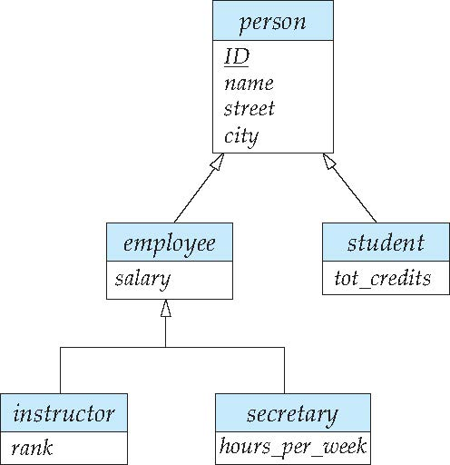
Specialization Example
Overlapping – employee and student
Disjoint – instructor and secretary
Total and partial

Slide 11
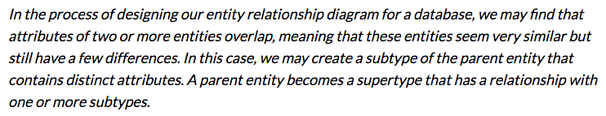
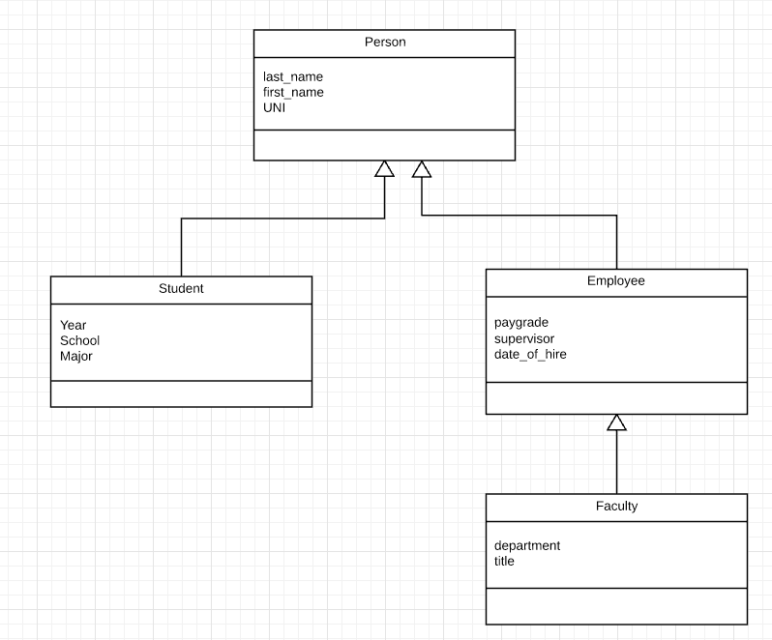
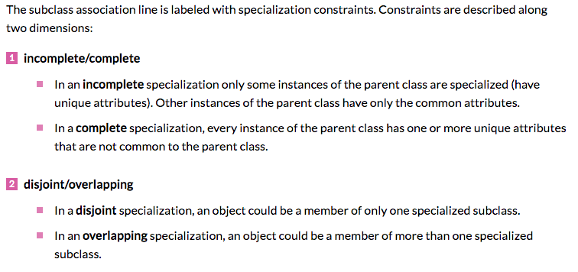
Inheritance/Specialization
Are all employees faculty?
Can students also be employees?
http://www.vertabelo.com/blog/technical-articles/inheritance-in-a-relational-database

Slide 12
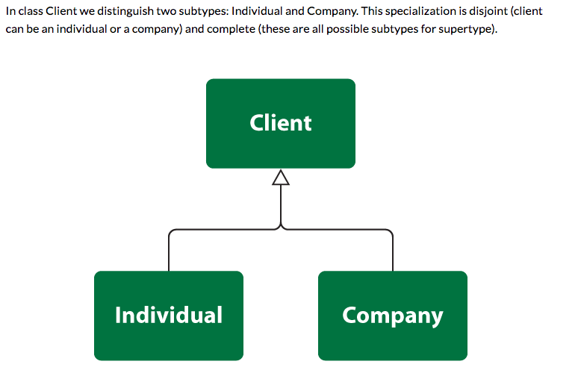
Specialization

Slide 13
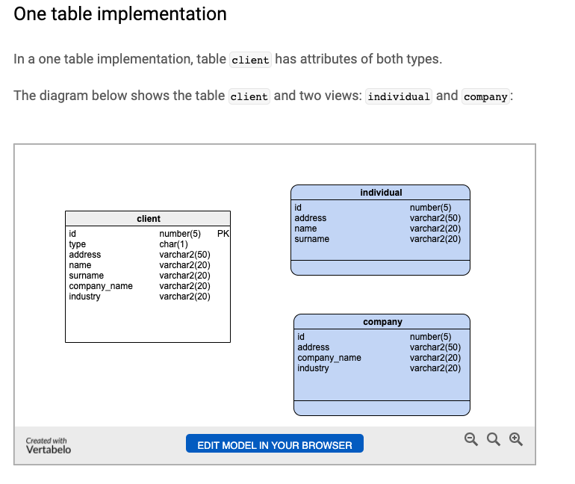
One Table
Views
Tables

Slide 14
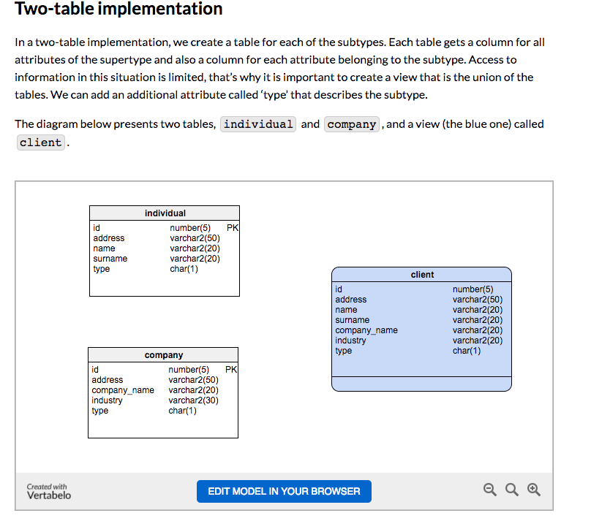
Two Table
View
Tables

Slide 15
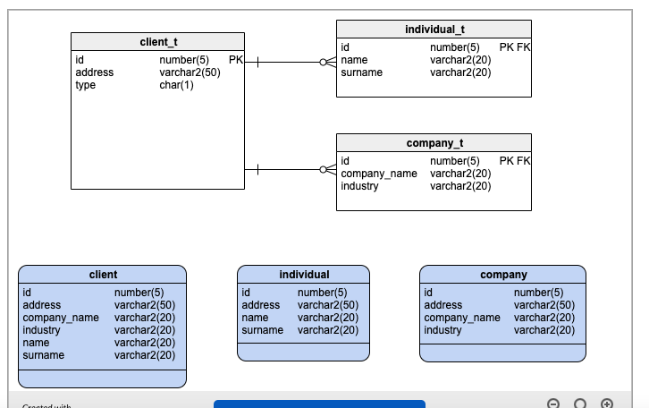
Three Table

Slide 16
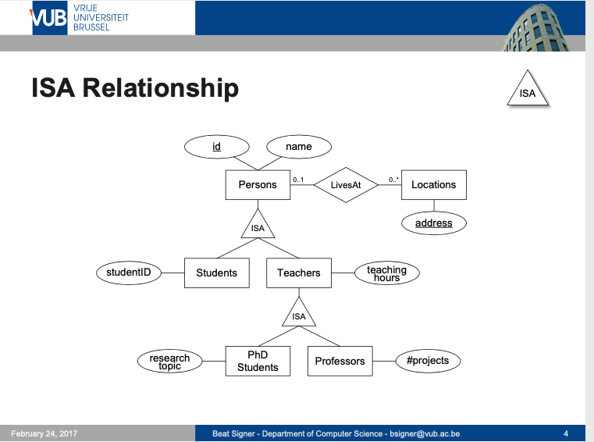
ISA Relationship

Slide 17
ER vs. UML Class Diagrams
ER Diagram Notation
Equivalent in UML
I use this approach in Crow’s Foot Notation but that is not standard.
* Generalization can use merged or separate arrows independent
of disjoint/overlapping

Slide 18
Complex Attributes
Introduction
18 | COMS W4111_003_2024_3: Lecture 5: ER(4), Relational(4), SQL(4) © Donald F. Ferguson, 2024

Slide 19
Complex Attributes
Attribute types:
Simple and composite attributes.
Single-valued and multivalued attributes
Example: multivalued attribute: phone_numbers
Derived attributes
Can be computed from other attributes
Example: age, given date_of_birth
Domain – the set of permitted values for each attribute
Not covered

Slide 20
Composite Attributes
Composite attributes allow us to divided attributes into subparts (other attributes).
Not covered

Slide 21
Entity Attributes
The relational model and well-designed SQL schema have atomic attributes.
There are several ways to think about attributes:
Simple (Atomic) vs Composite
Single Valued versus Multi-valued
Derived or Not Derived
And, there can be combinations, for example a Composite, Multi-Value Attribute. Phone number is an example:
A phone number is a composite (+1, 914-555-1212)
A customer may have several: work, home, mobile, … …
Examining name_basics from the IMDB dataset is interesting.
Not covered

Slide 22
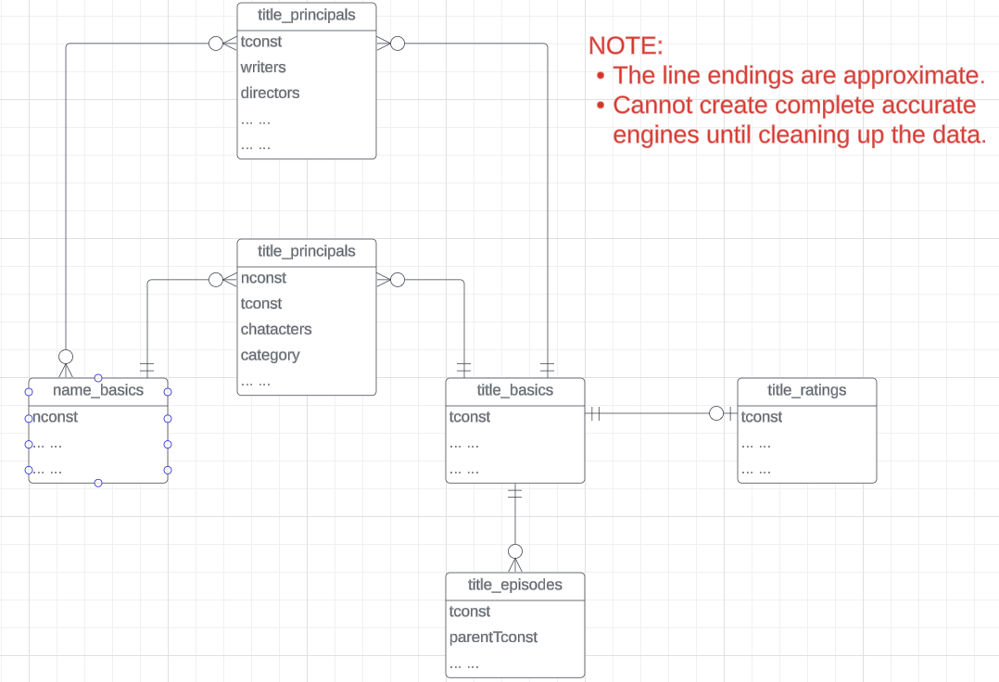
IMDB Free Data
IMDB Free Dataset is a set of TSV files:
Title Basics
Title AKAS
Title Crew
Title Episodes
Title Principals
Title Ratings
Name Basics
The data needs a lot of “clean up.”
Not covered
See /Users/donald.ferguson/Dropbox/000/000-A-Current-Examples/IMDB_GOT_Processing

Slide 23
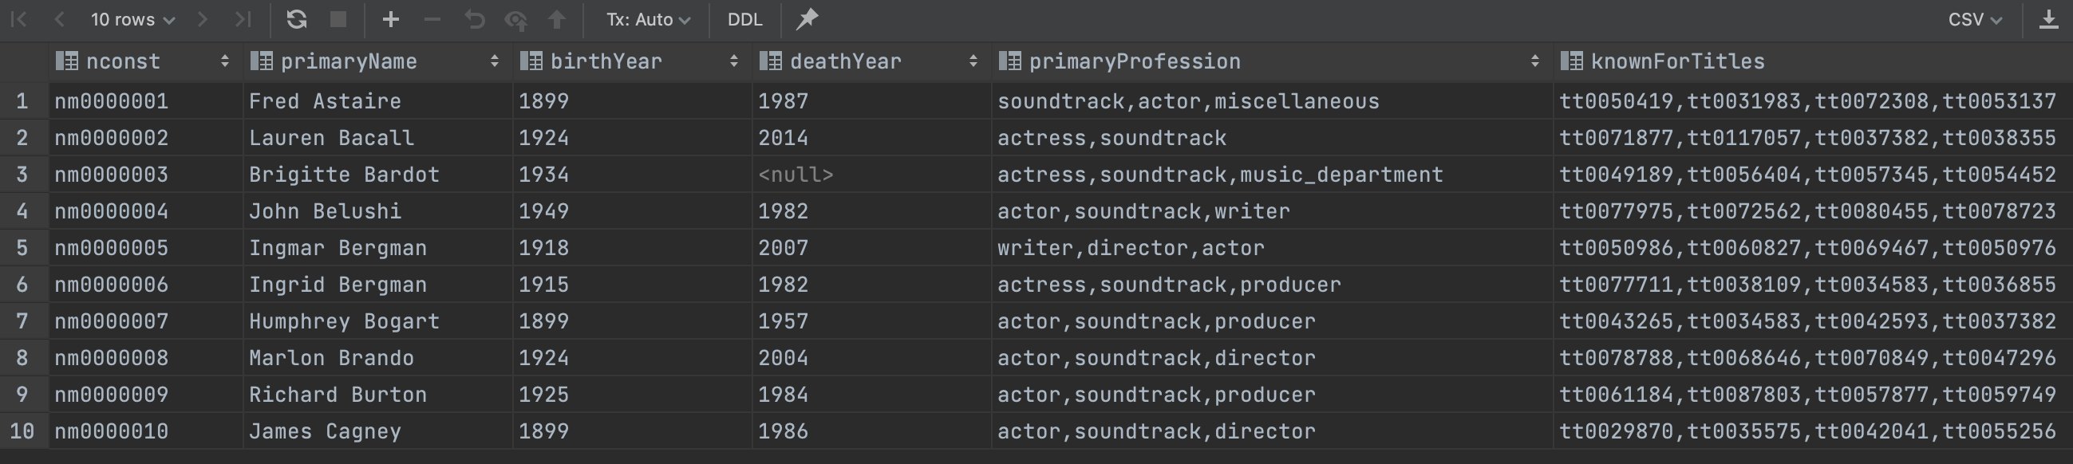
Example from IMDB
Switch to notebook
Consider name_basics
There
Is one composite attribute, primaryName.
Are two multivalued attributes: primaryProfession, knownForTitles
knownForTitles is also tricky, which we will see.
Names are also a little tricky

Slide 24
Aggregation
Introduction
24 | COMS W4111_003_2024_3: Lecture 5: ER(4), Relational(4), SQL(4) © Donald F. Ferguson, 2024

Slide 25
Aggregation
Consider the ternary relationship proj_guide, which we saw earlier
Suppose we want to record evaluations of a student by a guide on a project
Not covered

Slide 26
Aggregation (Cont.)
Relationship sets eval_for and proj_guide represent overlapping information
Every eval_for relationship corresponds to a proj_guide relationship
However, some proj_guide relationships may not correspond to any eval_for relationships
So we can’t discard the proj_guide relationship
Eliminate this redundancy via aggregation
Treat relationship as an abstract entity
Allows relationships between relationships
Abstraction of relationship into new entity
Not covered

Slide 27
Aggregation (Cont.)
Eliminate this redundancy via aggregation without introducing redundancy, the following diagram represents:
A student is guided by a particular instructor on a particular project
A student, instructor, project combination may have an associated evaluation
The simplest way to handle in relational is an associative entity.
Not covered
Some thoughts here: https://www.geeksforgeeks.org/aggregate-data-model-in-nosql/
Notes:
27

Slide 28
Reduction to Relational Schemas
To represent aggregation, create a schema containing
Primary key of the aggregated relationship,
The primary key of the associated entity set
Any descriptive attributes
In our example:
The schema eval_for is:
eval_for (s_ID, project_id, i_ID, evaluation_id)
The schema proj_guide is redundant.
Not covered

Slide 29
Let’s Examine and Do Some Examples
Students, Faculty, Person
Introduction
29 | COMS W4111_003_2024_3: Lecture 5: ER(4), Relational(4), SQL(4) © Donald F. Ferguson, 2024

Slide 30
Relational Model
30 | COMS W4111_003_2024_3: Lecture 5: ER(4), Relational(4), SQL(4) © Donald F. Ferguson, 2024

Slide 31
What are all those other Symbols?
Some of the operators are useful and “common,” but not always considered part of the core algebra.
Some of these are pretty obscure
Division
Anti-Join
Left semi-join
Right semi-join
Most SQL engines do not support them.
You can implement them using combinations of JOIN, SELECT, WHERE, ... ...
But, I cannot every remember using them in applications I have developed.
Outer JOIN is very useful, but less common. We will cover.
There are also some “patterns” or “terms”
Equijoin
Non-equi join
Natural join
Theta join
... ...
I may ask you to define these terms on some exams or the obscure operatorsbecause they may be common internships/job interview questions.
τ order by
γ group by
¬ negation
÷ set division
⨝ natural join, theta-join
⟕ left outer join
⟖ right outer join
⟗ full outer join
⋉ left semi join
⋊ right semi join
▷ anti-join

Slide 32
Thinking about JOINs
Some terms:
Natural Join
Equality of A and B columns
With the same name.
Equijoin
Explicitly specify columns that must have the same value.
A.x=B.z AND A.q=B.w
Theta Join: Arbitrary predicate.
Inner Join
JOIN “matches” rows in A and B.
Result contains ONLY the matched pairs.
What I want is:
All the rows that matched.
And the rows from A that did not match?
OUTER JOIN (⟖, ⟕)

Slide 33
What are all those other Symbols?
Some of the operators are useful and “common,” but not always considered part of the core algebra.
Some of these are pretty obscure
Division
Anti-Join
Left semi-join
Right semi-join
Most SQL engines do not support them.
You can implement them using combinations of JOIN, SELECT, WHERE, ... ...
But, I cannot every remember using them in applications I have developed.
Outer JOIN is very useful, but less common. We will cover.
There are also some “patterns” or “terms”
Equijoin
Non-equi join
Natural join
Theta join
... ...
I may ask you to define these terms on some exams or the obscure operatorsbecause they may be common internships/job interview questions.
τ order by
γ group by
¬ negation
÷ set division
⨝ natural join, theta-join
⟕ left outer join
⟖ right outer join
⟗ full outer join
⋉ left semi join
⋊ right semi join
▷ anti-join

Slide 34
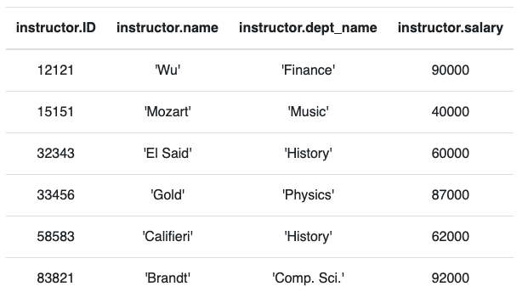
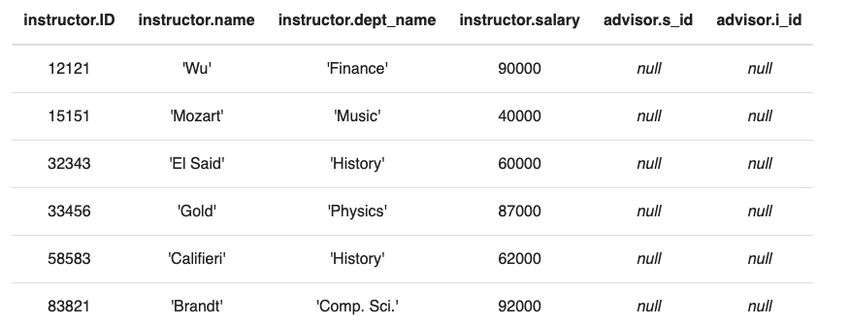
Anti – Join
“An anti-join is when you would like to keep all of the records in the original table except those records that match the other table.”
instructor ▷ ID=i_id advisor
σ i_id=null (instructor ⟕ ID=i_id advisor)

Slide 35
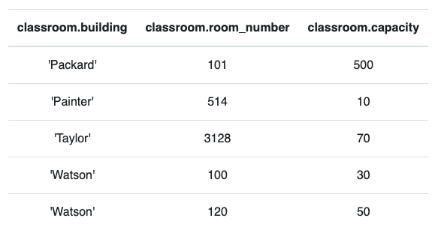
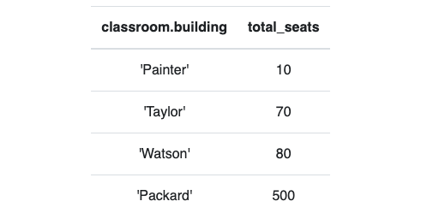
Group By, Order By
classroom
These are very simple examples.
We can apply them to relations created by operations on other tables.
τ total_seats (γ building; sum(capacity)→total_seats (classroom))

Slide 36
SQL
36 | COMS W4111_003_2024_3: Lecture 5: ER(4), Relational(4), SQL(4) © Donald F. Ferguson, 2024

Slide 37
Set Operations
Introduction
37 | COMS W4111_003_2024_3: Lecture 5: ER(4), Relational(4), SQL(4) © Donald F. Ferguson, 2024

Slide 38
Set Operations
Find courses that ran in Fall 2017 or in Spring 2018
(select course_id from section where sem = 'Fall' and year = 2017) union (select course_id from section where sem = 'Spring' and year = 2018)
Find courses that ran in Fall 2017 and in Spring 2018
(select course_id from section where sem = 'Fall' and year = 2017) intersect (select course_id from section where sem = 'Spring' and year = 2018)
Find courses that ran in Fall 2017 but not in Spring 2018
(select course_id from section where sem = 'Fall' and year = 2017) except (select course_id from section where sem = 'Spring' and year = 2018)
Note:
Show in Relax calculator.
Not all databases support INTERSECT and EXCEPT
We will see how to handle below.

Slide 39
Set Operations (Cont.)
Set operations union, intersect, and except
Each of the above operations automatically eliminates duplicates
To retain all duplicates use the
union all,
intersect all
except all.

Slide 40
Subqueries Concepts and Examples (Including Set Membership)
Introduction
40 | COMS W4111_003_2024_3: Lecture 5: ER(4), Relational(4), SQL(4) © Donald F. Ferguson, 2024

Slide 41
Nested Subqueries
SQL provides a mechanism for the nesting of subqueries. A subquery is a select-from-where expression that is nested within another query.
The nesting can be done in the following SQL query select A₁, A₂, ..., A_{n} from r₁, r₂, ..., r_{m} where P
as follows:
From clause: r_{i} can be replaced by any valid subquery
Where clause: P can be replaced with an expression of the form:
B <operation> (subquery)
B is an attribute and <operation> to be defined later.
Select clause:
A_{i} can be replaced be a subquery that generates a single value.
Covered. Review.
Note:
This is a little cryptic.
I think I know what they mean.
There are some operations we will see later in the material, e.g IN, EXISTS, ... ...

Slide 42
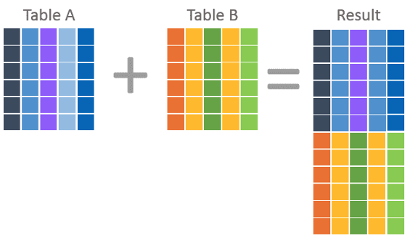
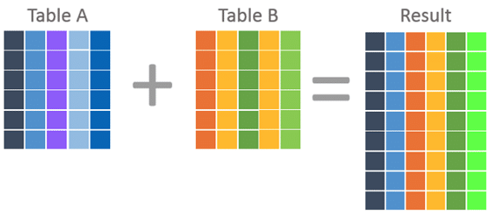
Nested Subquery
The slides that come with the book have surprisingly little material on nested subqueries.
The concept is:
Extremely important.
Students often find subqueries more confusing than joins.
The relationship/difference of subqueries to joins is often, initial unclear.
We have seen:
Union sort of puts a table on top of a table.
Join puts tables sort of puts tables side-by-side.
Subquery enables one query to call another during execution like a subfunction.
Covered. Review.

Slide 43
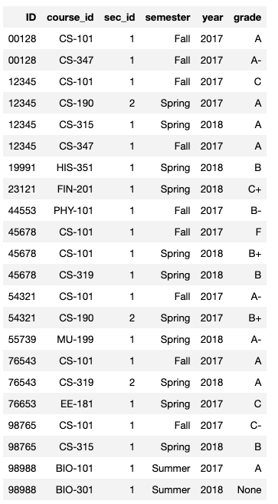
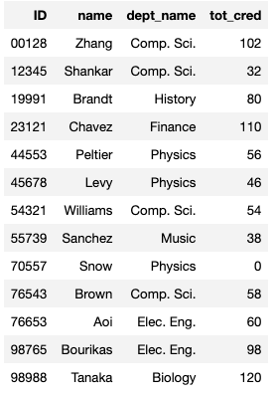
Consider Some Tables
Student
Takes
Covered. Review.

Slide 44
Consider a Subquery Tables
select *, (select name from student where student.id=takes.id) as name from takes;
Takes
Assume I wrote a function find_student_name(x)
Input is an x
Loops through all students and returns students with student.ID = x.
The query with a subquery above is like:
result = []
For t in takes:
new_r = t + find_student_name(t.id)
result.append(new_r)
Student
Covered. Review.

Slide 45
Nested Subqueries
SQL provides a mechanism for the nesting of subqueries. A subquery is a select-from-where expression that is nested within another query.
The nesting can be done in the following SQL query select A₁, A₂, ..., A_{n} from r₁, r₂, ..., r_{m} where P
as follows:
From clause: r_{i} can be replaced by any valid subquery
Where clause: P can be replaced with an expression of the form:
B <operation> (subquery)
B is an attribute and <operation> to be defined later.
Select clause:
A_{i} can be replaced be a subquery that generates a single value.
Note: Subquery MUST return
A single scalar if in the SELECT.
A Table if in the FROM.
If in the WHERE:
Either a scalar or a table.
Depending on the operation.
Covered. Review.

Slide 46
Subqueries Concepts and Examples (Including Set Membership)
Introduction
46 | COMS W4111_003_2024_3: Lecture 5: ER(4), Relational(4), SQL(4) © Donald F. Ferguson, 2024

Slide 47
Set Membership
Find courses offered in Fall 2017 and in Spring 2018
Find courses offered in Fall 2017 but not in Spring 2018
select distinct course_id
from section
where semester = 'Fall' and year= 2017 and course_id in (select course_id
from section
where semester = 'Spring' and year= 2018);
select distinct course_id
from section
where semester = 'Fall' and year= 2017 and course_id not in (select course_id
from section
where semester = 'Spring' and year= 2018);

Slide 48
Set Membership (Cont.)
Name all instructors whose name is neither “Mozart” nor Einstein”
select distinct name
from instructor
where name not in ('Mozart', 'Einstein')
Find the total number of (distinct) students who have taken course sections taught by the instructor with ID 10101
Note: Above query can be written in a much simpler manner. The formulation above is simply to illustrate SQL features
select count (distinct ID)
from takes
where (course_id, sec_id, semester, year) in (select course_id, sec_id, semester, year
from teaches
where teaches.ID= 10101);

Slide 49
Set Comparison

Slide 50
Set Comparison – “some” Clause
Find names of instructors with salary greater than that of some (at least one) instructor in the Biology department.
Same query using > some clause
select distinct T.name
from instructor as T, instructor as S
where T.salary > S.salary and S.dept name = 'Biology';
select name
from instructor
where salary > some (select salary
from instructor
where dept name = 'Biology');

Slide 51
Definition of “some” Clause
F <comp> some r ⇔ ∃ t ∈ r such that (F <comp> t ) Where <comp> can be: <, ≤, >, =, ≠
0
(5 < some
5
) = true
(read: 5 < some tuple in the relation)
6
0
(5 < some
5
) = false
0
(5 = some
) = true
5
0
(5 ≠ some
5
) = true (since 0 ≠ 5)
(= some) ≡ in
However, (≠ some) ≡ not in

Slide 52
Set Comparison – “all” Clause
Find the names of all instructors whose salary is greater than the salary of all instructors in the Biology department.
select name
from instructor
where salary > all (select salary
from instructor
where dept name = 'Biology');

Slide 53
Definition of “all” Clause
F <comp> all r ⇔ ∀ t ∈ r (F <comp> t)
0
(5 < all
5
) = false
6
6
(5 < all
) = true
10
4
(5 = all
) = false
5
4
(5 ≠ all
) = true (since 5 ≠ 4 and 5 ≠ 6)
6
(≠ all) ≡ not in
However, (= all) ≡ in

Slide 54
Test for Empty Relations
The exists construct returns the value true if the argument subquery is nonempty.
exists r ⇔ r ≠ Ø
not exists r ⇔ r = Ø

Slide 55
Use of “exists” Clause
Yet another way of specifying the query “Find all courses taught in both the Fall 2017 semester and in the Spring 2018 semester”
select course_id from section as S where semester = 'Fall' and year = 2017 and exists (select * from section as T where semester = 'Spring' and year= 2018 and S.course_id = T.course_id);
Correlation name – variable S in the outer query
Correlated subquery – the inner query

Slide 56
Use of “not exists” Clause
Find all students who have taken all courses offered in the Biology department.
Note that X – Y = Ø ⇔ X ⊆ Y
Note: Cannot write this query using = all and its variants
select distinct S.ID, S.name
from student as S
where not exists ( (select course_id
from course
where dept_name = 'Biology')
except
(select T.course_id
from takes as T
where S.ID = T.ID));
First nested query lists all courses offered in Biology
Second nested query lists all courses a particular student took

Slide 57
Test for Absence of Duplicate Tuples
The unique construct tests whether a subquery has any duplicate tuples in its result.
The unique construct evaluates to “true” if a given subquery contains no duplicates .
Find all courses that were offered at most once in 2017
select T.course_id from course as T where unique ( select R.course_id from section as R where T.course_id= R.course_id and R.year = 2017);

Slide 58
Subqueries in the From Clause

Slide 59
Subqueries in the Form Clause
SQL allows a subquery expression to be used in the from clause
Find the average instructors’ salaries of those departments where the average salary is greater than $42,000.”
select dept_name, avg_salary from ( select dept_name, avg (salary) as avg_salary from instructor group by dept_name) where avg_salary > 42000;
Note that we do not need to use the having clause
Another way to write above query
select dept_name, avg_salary from ( select dept_name, avg (salary) from instructor group by dept_name)
as dept_avg (dept_name, avg_salary)
where avg_salary > 42000;

Slide 60
With Clause
The with clause provides a way of defining a temporary relation whose definition is available only to the query in which the with clause occurs.
Find all departments with the maximum budget with max_budget (value) as (select max(budget) from department) select department.name from department, max_budget where department.budget = max_budget.value;

Slide 61
Complex Queries using With Clause
Find all departments where the total salary is greater than the average of the total salary at all departments
with dept _total (dept_name, value) as
(select dept_name, sum(salary)
from instructor
group by dept_name),
dept_total_avg(value) as
(select avg(value)
from dept_total)
select dept_name
from dept_total, dept_total_avg
where dept_total.value > dept_total_avg.value;

Slide 62
Scalar Subquery
Scalar subquery is one which is used where a single value is expected
List all departments along with the number of instructors in each department
select dept_name, ( select count(*) from instructor where department.dept_name = instructor.dept_name) as num_instructors from department;
Runtime error if subquery returns more than one result tuple

Slide 63

Some Types and Functions
63 | COMS W4111_003_2024_3: Lecture 5: ER(4), Relational(4), SQL(4) © Donald F. Ferguson, 2024

Slide 64
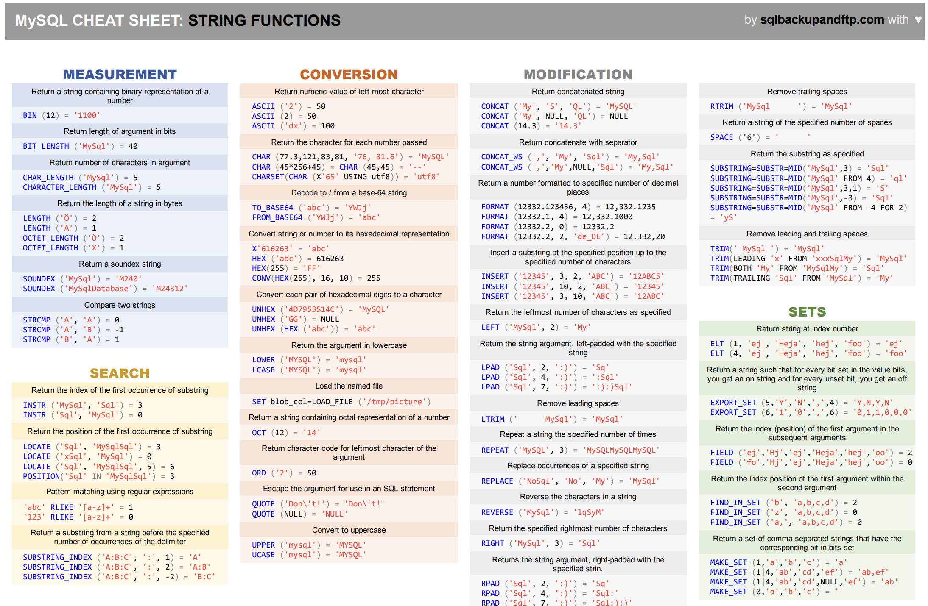
Functions

Slide 65
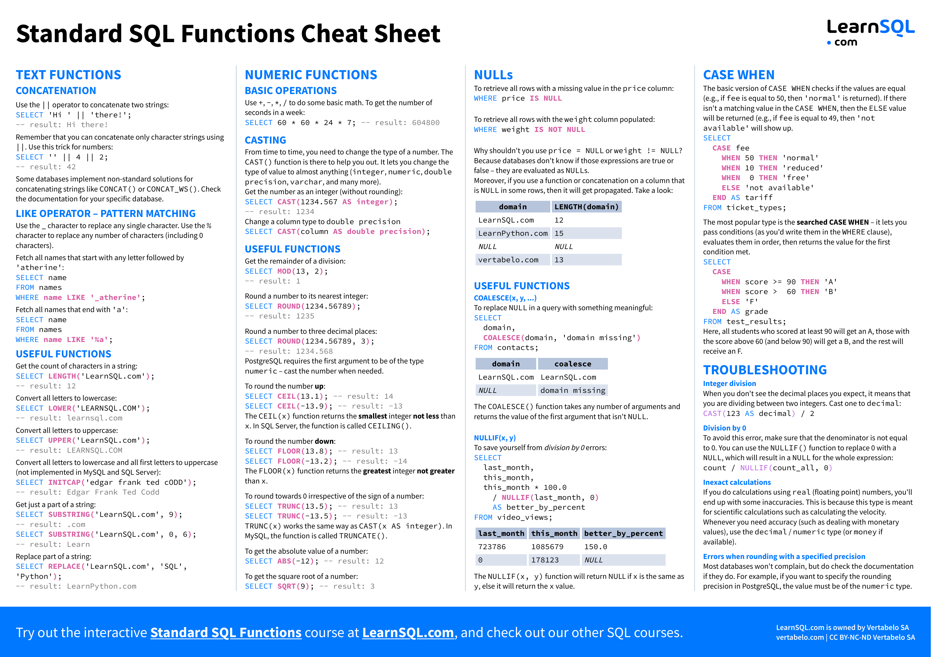
Functions

Slide 66
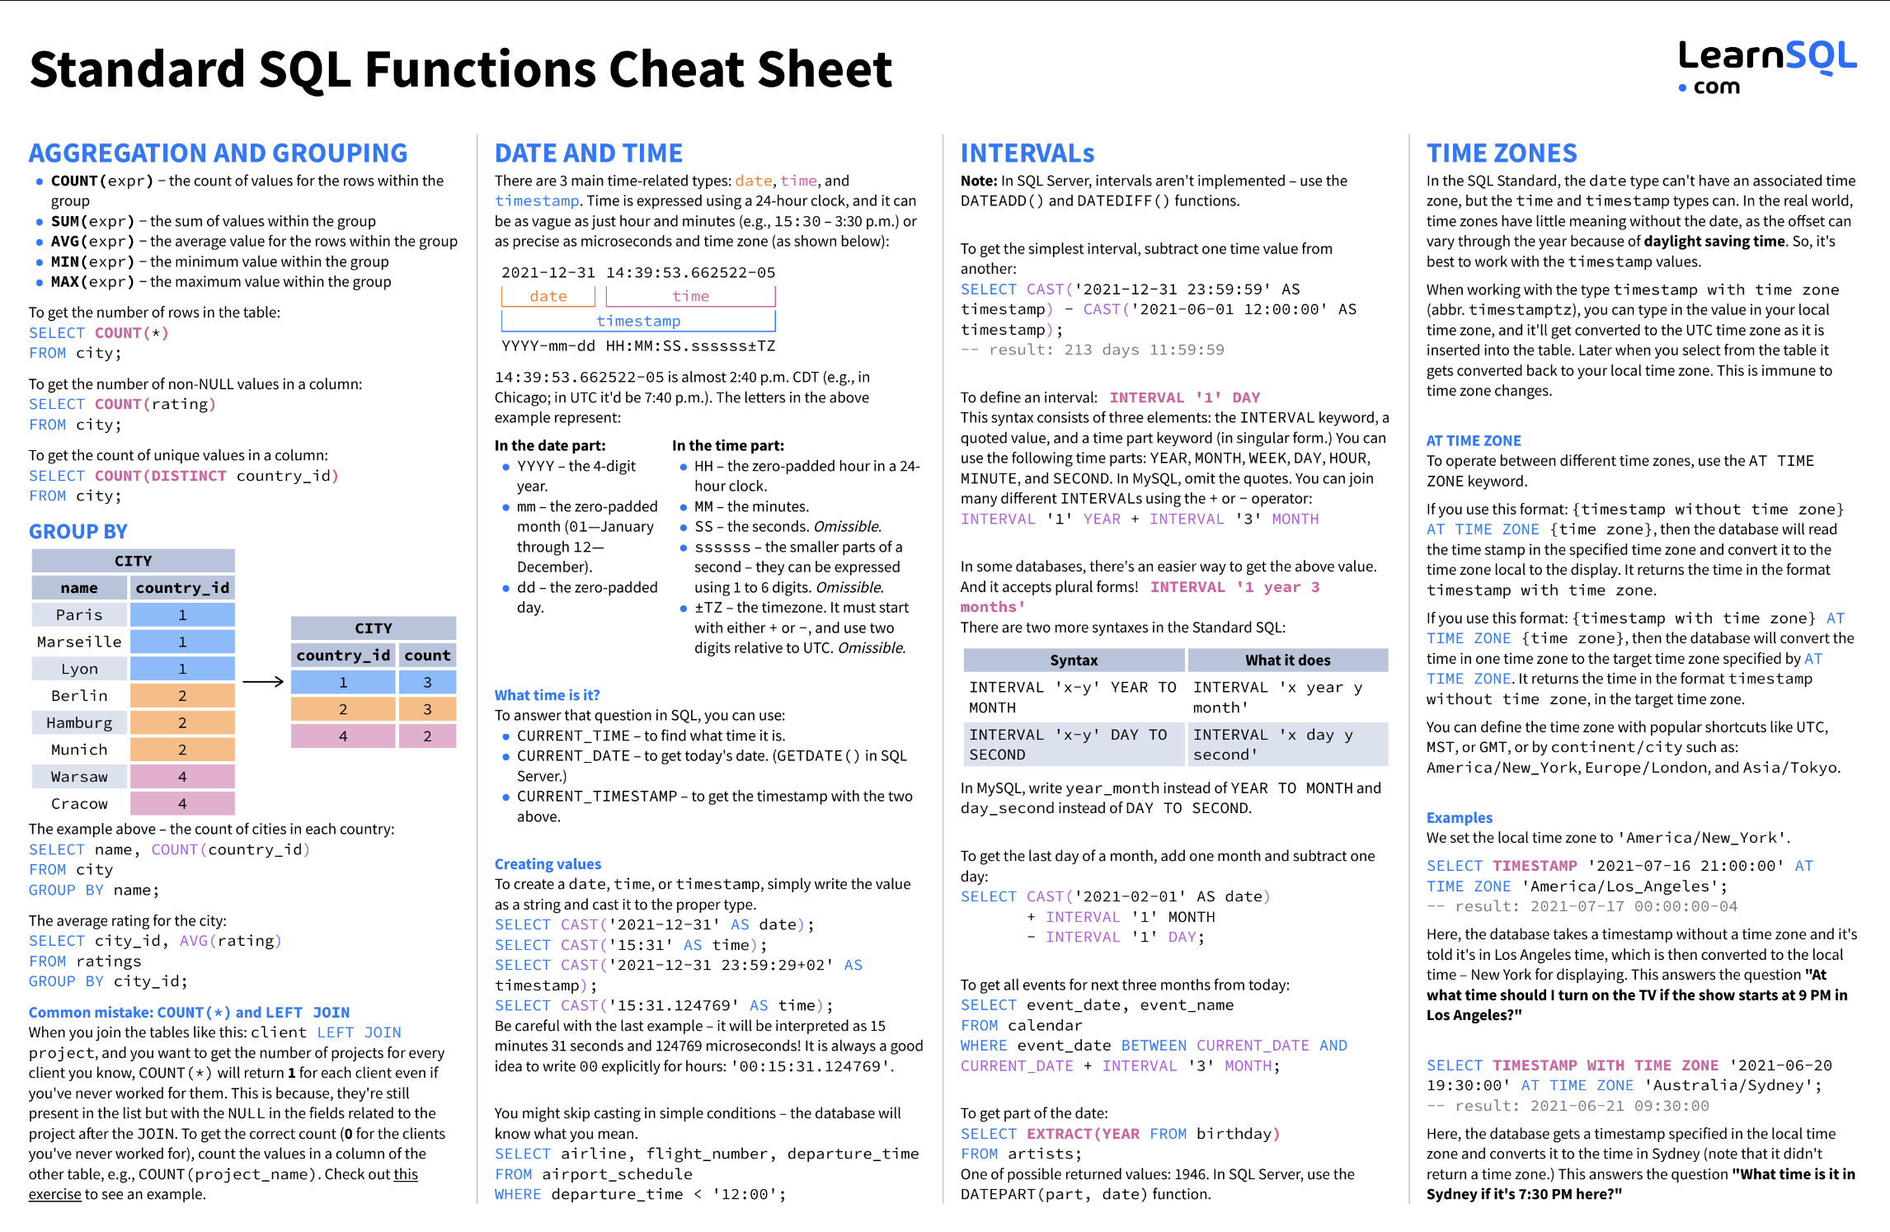
Functions

Slide 67
Functions
The are dozens if not hundreds of standard functions in SQL.
All DBMS implementations have product specific functions.
General rule:
If you have to do something, ask yourself
Am I the first one who ever had to do this?
If the answer is “No,” then ask Dr. Google/ChatGPT.
If the answer is Yes,” ask yourself, “Am I sure this is a good idea.”
The functions are useful and straightforward.
Some examples ➔ To the notebook we go, yo ho!

Slide 68
Views
68 | COMS W4111_003_2024_3: Lecture 5: ER(4), Relational(4), SQL(4) © Donald F. Ferguson, 2024

Slide 69
Views
In some cases, it is not desirable for all users to see the entire logical model (that is, all the actual relations stored in the database.)
Consider a person who needs to know an instructors name and department, but not the salary. This person should see a relation described, in SQL, by select ID, name, dept_name from instructor
A view provides a mechanism to hide certain data from the view of certain users.
Any relation that is not of the conceptual model but is made visible to a user as a “virtual relation” is called a view.

Slide 70
View Definition
A view is defined using the create view statement which has the form
create view v as < query expression >
where <query expression> is any legal SQL expression. The view name is represented by v.
Once a view is defined, the view name can be used to refer to the virtual relation that the view generates.
View definition is not the same as creating a new relation by evaluating the query expression
Rather, a view definition causes the saving of an expression; the expression is substituted into queries using the view.

Slide 71
View Definition and Use
A view of instructors without their salary
create view faculty as select ID, name, dept_name from instructor
Find all instructors in the Biology department
select name from faculty where dept_name = 'Biology'
Create a view of department salary totals
create view departments_total_salary(dept_name, total_salary) as select dept_name, sum (salary) from instructor group by dept_name;

Slide 72
Views Defined Using Other Views
One view may be used in the expression defining another view
A view relation v₁ is said to depend directly on a view relation v₂ if v₂ is used in the expression defining v₁
A view relation v₁ is said to depend on view relation v₂ if either v₁ depends directly to v₂ or there is a path of dependencies from v₁ to v₂
A view relation v is said to be recursive if it depends on itself.

Slide 73
Views Defined Using Other Views
create view physics_fall_2017 as select course.course_id, sec_id, building, room_number from course, section where course.course_id = section.course_id and course.dept_name = 'Physics' and section.semester = 'Fall' and section.year = '2017’;
create view physics_fall_2017_watson as select course_id, room_number from physics_fall_2017 where building= 'Watson';

Slide 74
View Expansion
Expand the view :
create view physics_fall_2017_watson as select course_id, room_number from physics_fall_2017 where building= 'Watson'
To:
create view physics_fall_2017_watson as
select course_id, room_number
from (select course.course_id, building, room_number
from course, section
where course.course_id = section.course_id
and course.dept_name = 'Physics'
and section.semester = 'Fall'
and section.year = '2017')
where building= 'Watson';

Slide 75
View Expansion (Cont.)
A way to define the meaning of views defined in terms of other views.
Let view v₁ be defined by an expression e₁ that may itself contain uses of view relations.
View expansion of an expression repeats the following replacement step:
repeat Find any view relation v_{i} in e₁ Replace the view relation v_{i} by the expression defining v_{i} until no more view relations are present in e₁
As long as the view definitions are not recursive, this loop will terminate

Slide 76
Materialized Views
Certain database systems allow view relations to be physically stored.
Physical copy created when the view is defined.
Such views are called Materialized view:
If relations used in the query are updated, the materialized view result becomes out of date
Need to maintain the view, by updating the view whenever the underlying relations are updated.

Slide 77
Update of a View
Add a new tuple to faculty view which we defined earlier
insert into faculty
values ('30765', 'Green', 'Music');
This insertion must be represented by the insertion into the instructor relation
Must have a value for salary.
Two approaches
Reject the insert
Inset the tuple
('30765', 'Green', 'Music', null)
into the instructor relation

Slide 78
Some Updates Cannot be Translated Uniquely
create view instructor_info as select ID, name, building from instructor, department where instructor.dept_name= department.dept_name;
insert into instructor_info
values ('69987', 'White', 'Taylor');
Issues
Which department, if multiple departments in Taylor?
What if no department is in Taylor?

Slide 79
And Some Not at All
create view history_instructors as select * from instructor where dept_name= 'History';
What happens if we insert
('25566', 'Brown', 'Biology', 100000)
into history_instructors?

Slide 80
View Updates in SQL
Most SQL implementations allow updates only on simple views
The from clause has only one database relation.
The select clause contains only attribute names of the relation, and does not have any expressions, aggregates, or distinct specification.
Any attribute not listed in the select clause can be set to null
The query does not have a group by or having clause.

Slide 81
Codd’s 12 Rules Metadata
81 | COMS W4111_003_2024_3: Lecture 5: ER(4), Relational(4), SQL(4) © Donald F. Ferguson, 2024

Slide 82
Codd’s 12 Rules
Rule 1: Information Rule
The data stored in a database, may it be user data or metadata, must be a value of some table cell. Everything in a database must be stored in a table format.
Rule 2: Guaranteed Access Rule
Every single data element (value) is guaranteed to be accessible logically with a combination of table-name, primary-key (row value), and attribute-name (column value). No other means, such as pointers, can be used to access data.
Rule 3: Systematic Treatment of NULL Values
The NULL values in a database must be given a systematic and uniform treatment. This is a very important rule because a NULL can be interpreted as one the following − data is missing, data is not known, or data is not applicable.
Rule 4: Active Online Catalog
The structure description of the entire database must be stored in an online catalog, known as data dictionary, which can be accessed by authorized users. Users can use the same query language to access the catalog which they use to access the database itself.
Rule 5: Comprehensive Data Sub-Language Rule
A database can only be accessed using a language having linear syntax that supports data definition, data manipulation, and transaction management operations. This language can be used directly or by means of some application. If the database allows access to data without any help of this language, then it is considered as a violation.
Rule 6: View Updating Rule
All the views of a database, which can theoretically be updated, must also be updatable by the system.

Slide 83
Codd’s 12 Rules
Rule 7: High-Level Insert, Update, and Delete Rule
A database must support high-level insertion, updation, and deletion. This must not be limited to a single row, that is, it must also support union, intersection and minus operations to yield sets of data records.
Rule 8: Physical Data Independence
The data stored in a database must be independent of the applications that access the database. Any change in the physical structure of a database must not have any impact on how the data is being accessed by external applications.
Rule 9: Logical Data Independence
The logical data in a database must be independent of its user’s view (application). Any change in logical data must not affect the applications using it. For example, if two tables are merged or one is split into two different tables, there should be no impact or change on the user application. This is one of the most difficult rule to apply.
Rule 10: Integrity Independence
A database must be independent of the application that uses it. All its integrity constraints can be independently modified without the need of any change in the application. This rule makes a database independent of the front-end application and its interface.
Rule 11: Distribution Independence
The end-user must not be able to see that the data is distributed over various locations. Users should always get the impression that the data is located at one site only. This rule has been regarded as the foundation of distributed database systems.
Rule 12: Non-Subversion Rule
If a system has an interface that provides access to low-level records, then the interface must not be able to subvert the system and bypass security and integrity constraints.

Slide 84
Data Definition Language (DDL)
Specification notation for defining the database schema
Example: create table instructor ( ID char(5), name varchar(20), dept_name varchar(20), salary numeric(8,2))
DDL compiler generates a set of table templates stored in a data dictionary
Data dictionary contains metadata (i.e., data about data)
Database schema
Integrity constraints
Primary key (ID uniquely identifies instructors)
Authorization
Who can access what
Notes:
84

Slide 85
Metadata and Catalog
‘Metadata is "data that provides information about other data". In other words, it is "data about data". Many distinct types of metadata exist, including descriptive metadata, structural metadata, administrative metadata, reference metadata and statistical metadata.’ (https://en.wikipedia.org/wiki/Metadata)
“The database catalog of a database instance consists of metadata in which definitions of database objects such as base tables, views (virtual tables), synonyms, value ranges, indexes, users, and user groups are stored. ... ... The SQL standard specifies a uniform means to access the catalog, called the INFORMATION_SCHEMA, but not all databases follow this ...” (https://en.wikipedia.org/wiki/Database_catalog)
Codd’s Rule 4: Dynamic online catalog based on the relational model:
The data base description is represented at the logical level in the same way as ordinary data, so that authorized users can apply the same relational language to its interrogation as they apply to the regular data.

Slide 86
Data Dictionary Storage
The Data dictionary (also called system catalog) stores metadata; that is, data about data, such as
Information about relations
names of relations
names, types and lengths of attributes of each relation
names and definitions of views
integrity constraints
User and accounting information, including passwords
Statistical and descriptive data
number of tuples in each relation
Physical file organization information
How relation is stored (sequential/hash/…)
Physical location of relation
Information about indices (Chapter 14)

Slide 87
Relational Representation of System Metadata
Relational representation on disk
Specialized data structures designed for efficient access, in memory

Slide 88
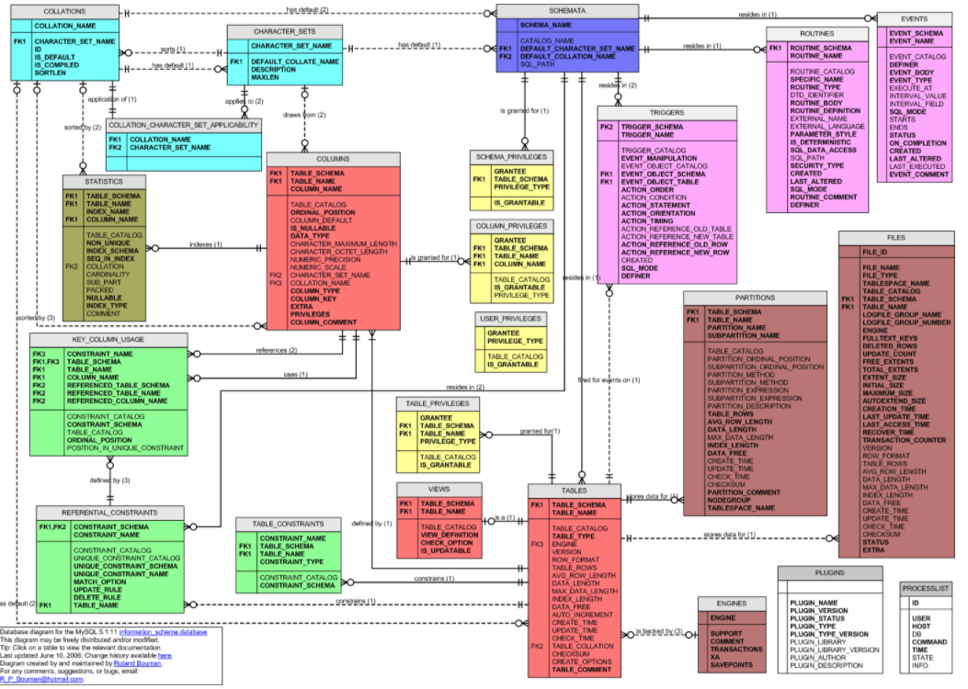
MySQL Catalog (Information_Schema)
Some of the MySQL Information Schema Tables:
'ADMINISTRABLE_ROLE_AUTHORIZATIONS'
'APPLICABLE_ROLES'
'CHARACTER_SETS'
'CHECK_CONSTRAINTS'
'COLUMN_PRIVILEGES'
'COLUMN_STATISTICS'
'COLUMNS'
'ENABLED_ROLES'
'ENGINES'
'EVENTS'
'FILES'
'KEY_COLUMN_USAGE'
'PARAMETERS'
'REFERENTIAL_CONSTRAINTS'
'RESOURCE_GROUPS'
'ROLE_COLUMN_GRANTS'
'ROLE_ROUTINE_GRANTS'
'ROLE_TABLE_GRANTS'
'ROUTINES'
'SCHEMA_PRIVILEGES'
'STATISTICS'
'TABLE_CONSTRAINTS'
'TABLE_PRIVILEGES'
'TABLES'
'TABLESPACES'
'TRIGGERS'
'USER_PRIVILEGES'
'VIEW_ROUTINE_USAGE'
'VIEW_TABLE_USAGE'
'VIEWS'
CREATE and ALTER statements modify the data.
DBMS reads information:
Parsing
Optimizer
etc.

Slide 89
Do Some Examples if not too Tired or Bored
Introduction
89 | COMS W4111_003_2024_3: Lecture 5: ER(4), Relational(4), SQL(4) © Donald F. Ferguson, 2024

Slide 90
REST
90 | COMS W4111_003_2024_3: Lecture 5: ER(4), Relational(4), SQL(4) © Donald F. Ferguson, 2024

Slide 91
Data Modeling Concepts and REST
Almost any data model has the same core concepts:
Types and instances:
Entity Type: A definition of a type of thing with properties and relationships.
Entity Instance: A specific instantiation of the Entity Type
Entity Set Instance: An Entity Type that:
Has properties and relationships like any entity, but ...
Has at least one special relationship – contains.
Operations, minimally CRUD, that manipulate entity types and instances:
Create
Retrieve
Update
Delete
Reference/Identify/... ...
Host/database/table/pk

Slide 92
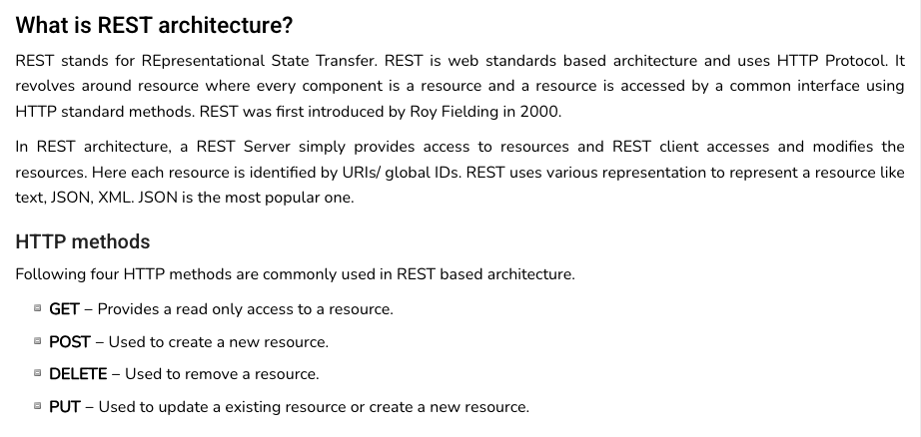
REST (https://www.tutorialspoint.com/restful/restful_introduction.htm)

Slide 93
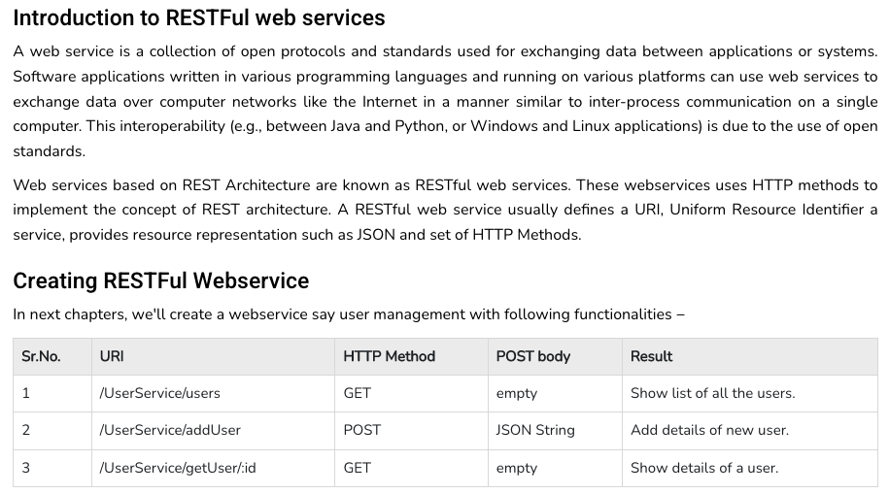
REST (https://www.tutorialspoint.com/restful/restful_introduction.htm)

Slide 94
REST and Resources

Slide 95
URLs

Slide 96
jdbc:mysql://columbia-examples.ckkqqktwkcji.us-east-1.rds.amazonaws.com:3306
GET http://localhost:5001/f23_imdb_clean/name_basics/nm0000158
GET http://localhost:5001/f23_imdb_clean/name_basics?deathYear=2023&birthyear=1960
select * from f23_imdb_clean.name_basics where
deathYear=2023 AND birthyear=1960
PUT http://localhost:5001/f23_imdb_clean/name_basics ?deathYear=2023&birthyear=1960
Body {‘primaryName’: ‘Does not matter cause is dead.’}
update f23_imdb_clean.name_basics
set
where deathYear=2023 AND birthyear=1960

Slide 97
Simplistic, Conceptual Mapping (Examples)
REST Method | Resource Path | Relational Operation | DB Resource
DELETE | /people | DROP TABLE | people table
POST | /people | INSERT INTO PEOPLE (...) VALUES(...) | people table people row
GET | /people/21 | SHOW KEYS FROM people ...; SELECT * FROM people WHERE playerID= 21 | people row
GET | /people/21/batting | SELECT batting.* FROM people JOIN batting USING(playerID) WHERE playerID=21
GET | /people/21/batting/2004_1 | SELECT batting.* FROM people JOIN batting USING(playerID) WHERE playerID=21 AND yearID=2004 AND stint=1

Slide 98
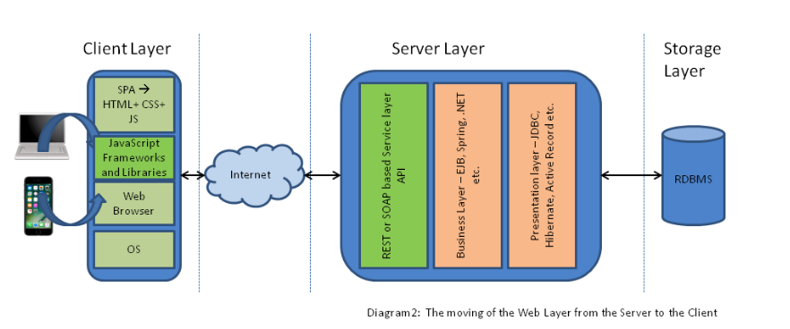
Application Architecture

